Slide 1


SWARMFRAME
=
« Monitor Your Robot »
ENSTA Bretagne Monitor Your Robot 1 / 49
Notes:
Hello
Benoit and I

Slide 2
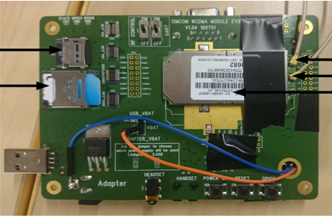
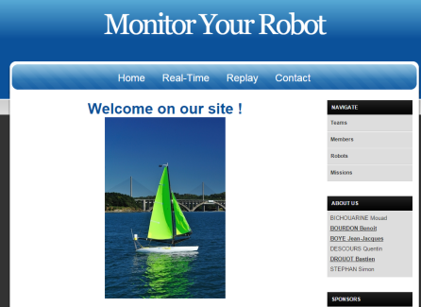
What is Monitor Your Robot
Subject
SWARMON project
SWARMON internship
MYR
Members
5 students
(Benoit and 4 students)
2 students
(Benoit and Bastien)
2 students
(Benoit and Bastien)
Time span
1 year
2 months
3 weeks
Result
Tracker
Web site
Real time + Generator
ENSTA Bretagne Monitor Your Robot 2 / 49
Notes:
The aim of the SWORMON project is to create a tracker
Tracker gather coordinate
Benoit and I have made this intership
The aim … a website in order to visualise the possition of a tracker on a map
Tracker gather coordinate

Slide 3
Plan:
I. Methods of work
Agile Development MYR
Quality Commitment in MYR
II. Improvements since SWARMON
Changes in the Map rendering
Example of implementation
Improvement in the CSS and the Layout
Improvement in the database
III. New technologies in MYR
How to use Ajax in Rails
Website generator
Impact on performance
ENSTA Bretagne Monitor Your Robot 3 / 49
Notes:
In order to expose you
I will let benoit explain you the whereabouts of the first part

Slide 4
I. Methods of work
Agile Development MYR
Quality Commitment in MYR
II. Improvements since SWARMON
Changes in the Map rendering
Example of implementation
Improvement in the CSS and the Layout
Improvement in the database
III. New technologies in MYR
How to use Ajax in Rails
Website generator
Impact on performance
Agile development in “Monitor Your Robot”
ENSTA Bretagne Monitor Your Robot 4 / 49

Slide 5
Agile Development in « Monitor Your Robot »
Test Driven
Stormboard
GitHub
« Fail Faster »
+ Fallback possibilities
Prototyping
+ « Minimum Viable Product »
« Keep it simple »
Rails Migration
Scrum Management
Daily meeting
Incremental learning
Gantt
Milestones
+ Reporting
Needed abilities
+ Learning
Frequent reporting
Known technologies
ENSTA Bretagne Monitor Your Robot 5 / 49

Slide 6
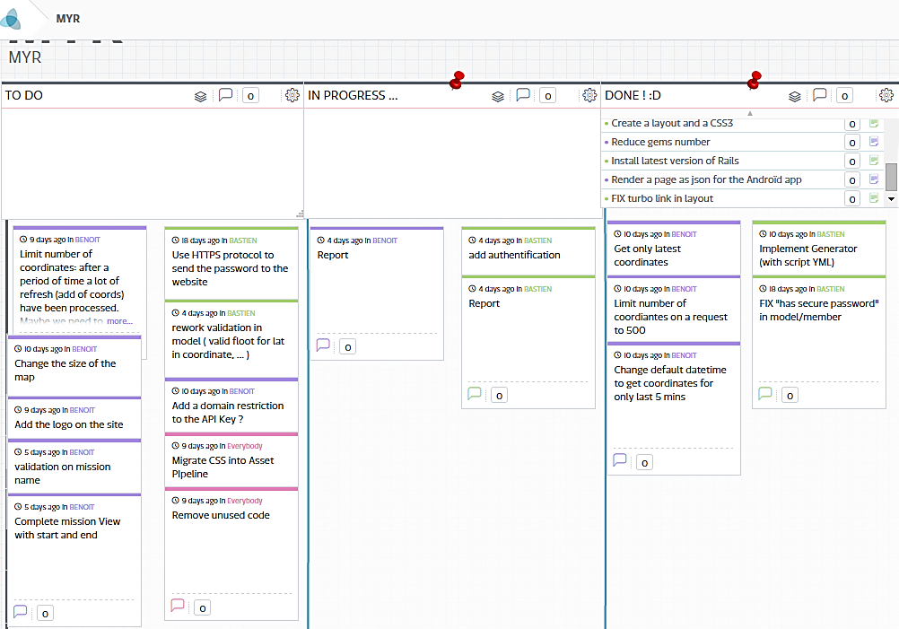
« Stormboard » of Monitor Your Robot
ENSTA Bretagne Monitor Your Robot 6 / 49

Slide 7
I. Methods of work
Agile Development MYR
Quality Commitment in MYR
II. Improvements since SWARMON
Changes in the Map rendering
Example of implementation
Improvement in the CSS and the Layout
Improvement in the database
III. New technologies in MYR
How to use Ajax in Rails
Website generator
Impact on performance
“Monitor Your Robot”
Commitment of Quality
ENSTA Bretagne Monitor Your Robot 7 / 49

Slide 8
« Monitor Your Robot » Commitment of quality
Jquery
Shared pages
Readable Code
+ User-friendly languages
Clear Interface with SWARMAPP
Yaml
Gestion of errors
Only useful gems
Rake script
Use Google Map API V3
Asset Pipeline
Dedicated Jquery Library for Google Map
Beautiful and effective methods
Shared functions
Non obtrusive JavaScript
ENSTA Bretagne Monitor Your Robot 8 / 49

Slide 9
Plan:
I. Methods of work
Agile Development MYR
Quality Commitment in MYR
II. Improvements since SWARMON
Changes in the Map rendering
Example of implementation
Improvement in the CSS and the Layout
Improvement in the database
III. New technologies in MYR
How to use Ajax in Rails
Website generator
Impact on performance
ENSTA Bretagne Monitor Your Robot 9 / 49

Slide 10
I. Methods of work
Agile Development MYR
Quality Commitment in MYR
II. Improvements since SWARMON
Changes in the Map rendering
Example of implementation
Improvement in the CSS and the Layout
Improvement in the database
III. New technologies in MYR
How to use Ajax in Rails
Website generator
Impact on performance
Changes in the map rendering
ENSTA Bretagne Monitor Your Robot 10 / 49

Slide 11
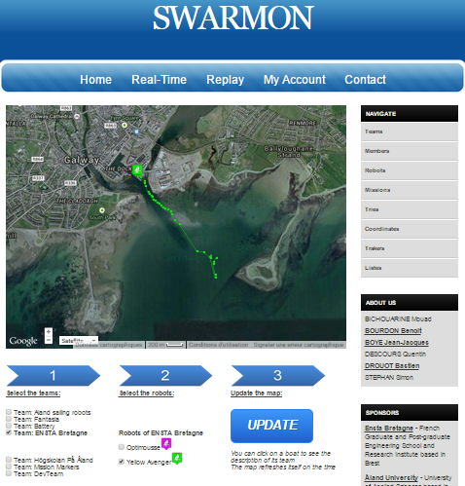
Aspect of the « Real-Time » page of SWARMON
Terms definition
VIEW
or
PAGE
MAP
GUI
ENSTA Bretagne Monitor Your Robot 11 / 49

Slide 12
Changes in map rendering
SWARMON Monitor Your Robot
Gem Gmap4rails
Fast to implement across Rails
Less customizable
Numerous calls to Google Map
Refresh
Add again all the coordinates
Programming
Jquery on each partial page
Disable Turbolinks
Graphical User Interface
Dynamic with Ajax and .erb
Allow to chose teams / robots
Cookies “shared” with Replay
Use of Google Map API
Easy to handle when knowing Rails
Completely customizable
Complete total on JavaScript calls
Refresh
Only add the latest coordinates
Programming
Unobstrusive JavaScript
Asset pipeline + Turbolinks
Graphical User Interface
Current mission + description
Fully ready to display “markers”
Other parts will be kept
ENSTA Bretagne Monitor Your Robot 12 / 49

Slide 13
Other changes in MYR
Shared pages with SWARMAPP
Clean error management with HTML code
New database which adds the table « Markers »
Creation of a tool to add « mission’s markers »
New design for the “Real-Time” page
Use of a website generator
New CSS and layout
ENSTA Bretagne Monitor Your Robot 13 / 49

Slide 14
I. Methods of work
Agile Development MYR
Quality Commitment in MYR
II. Improvements since SWARMON
Changes in the Map rendering
Example of implementation
Improvement in the CSS and the Layout
Improvement in the database
III. New technologies in MYR
How to use Ajax in Rails
Website generator
Impact on performance
Examples of implementation
ENSTA Bretagne Monitor Your Robot 14 / 49

Slide 15
Interface with SWARMAPP
ENSTA Bretagne Monitor Your Robot 15 / 49

Slide 16
Interface with SWARMAPP
Specific URLs have been created:
/what
/getCurrentMission
/getMissionLength
/getCoordsSince
/getCoordsSince?datetime=…
/getCoordsBetween?
/getCoordsBetween?tstart=…=tend=…
(proof that the website is compatible with the application)
(return the current mission)
(start and end of the current mission)
(if no parameter: start
of the current mission)
(if no parameter: start en end
of the current mission)
ENSTA Bretagne Monitor Your Robot 16 / 49

Slide 17
Creation of a tool to create « mission’s markers »
ENSTA Bretagne Monitor Your Robot 17 / 49

Slide 18
Administration tool to add markers to a specific mission
Select a mission:
< Mission 1 >
Add a boil
Add a start / end line
Add a delimitation zone
SAVE ALL MARKERS
ENSTA Bretagne Monitor Your Robot 18 / 49

Slide 19
Display of markers in the newly designed « real-time » page
MISSION
Current mission is: « Fleet Race »
Start and End time: 8:00 to 12:00
Description of the mission: «A race of robots »
Markers of the mission:
boil start line
Id:1
ROBOTS:
R2D2
C3PO
OPTIONS:
Display last 5 minutes
Auto refresh
Display markers on map
Go full screen
ENSTA Bretagne Monitor Your Robot 19 / 49

Slide 20
I. Methods of work
Agile Development MYR
Quality Commitment in MYR
II. Improvements since SWARMON
Changes in the Map rendering
Example of implementation
Improvement in the CSS and the Layout
Improvement in the database
III. New technologies in MYR
How to use Ajax in Rails
Website generator
Impact on performance
Improvements in the CSS
and the Layout
ENSTA Bretagne Monitor Your Robot 20 / 49
Notes:
Now we can talk about the improvement

Slide 21

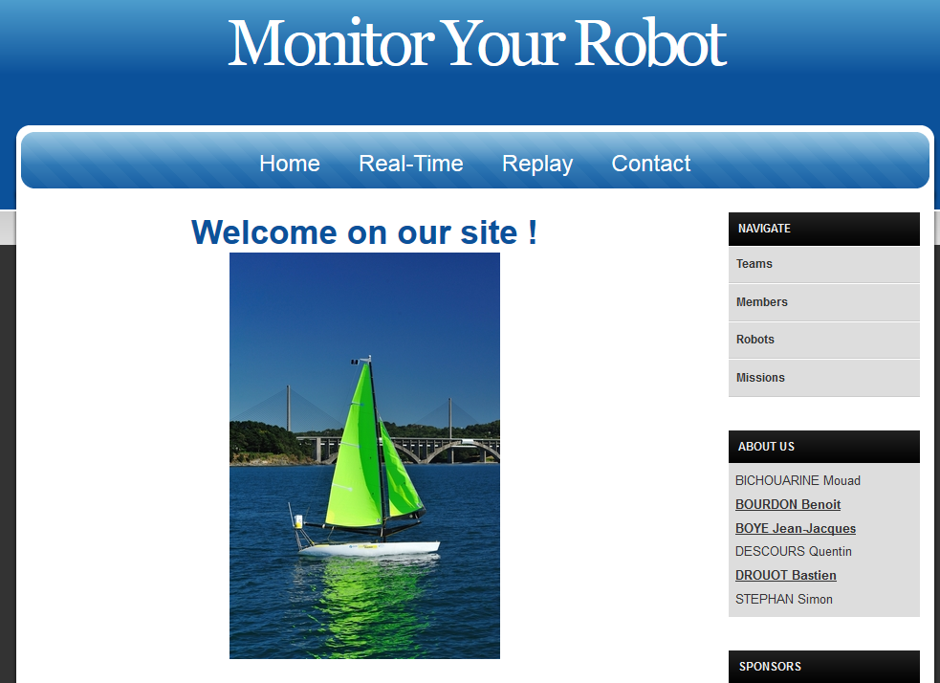
CSS 2
CSS 3
Html 3
Html 4
Static layout
Customizable layout
ENSTA Bretagne Monitor Your Robot 21 / 49
Notes:
The previous version of our website
Html 3 does not include all the function witch may be required by our website.
But HTML 4 can provide us those functions.
The web site created for the WRSC 2014 (project SWORMON) contains a no open sources CSS and Layout
moreover this CSS is not CSS3 (the last version of CSS). T
herefore we created a new Layout and selected a new CSS, an open source CSS3.

Slide 22
I. Methods of work
Agile Development MYR
Quality Commitment in MYR
II. Improvements since SWARMON
Changes in the Map rendering
Example of implementation
Improvement in the CSS and the Layout
Improvement in the database
III. New technologies in MYR
How to use Ajax in Rails
Website generator
Impact on performance
Improvements in the
data base
ENSTA Bretagne Monitor Your Robot 22 / 49
Notes:
Now we can talk about the improvements

Slide 23
Marker
Mission
Has many through
Id
Mission_id
Name
Description
Latitude
Longitude
Datetime
Id
Start
End
Name
Description
Has many
Belongs to
Member
Attempt
Tracker
Id
Mission_id
Robot_id
Tracker_id
Name
Start
End
Id
Team_id
Name
Password
Email
Role
Logo
Id
Token
Description
Coordinate
Robot
Team
Id
Tracker_id
Latitude
Longitude
Datetime
Id
Team_id
Name
Category
Id
Leader_id
Name
Logo
Description
ENSTA Bretagne Monitor Your Robot 23 / 49
Notes:
Our web site is dising for the WRSC.
WRSC => atempt
Attempt liked with 3 tables
Mission ( example)
Marker ( an imporatn coordinate, start point of the mission, … )
Tracker gather coordinate
It is like a doctor, a docrot has many patients through medical appointments

Slide 24
Plan:
I. Methods of work
Agile Development MYR
Quality Commitment in MYR
II. Improvements since SWARMON
Changes in the Map rendering
Example of implementation
Improvement in the CSS and the Layout
Improvement in the database
III. New technologies in MYR
How to use Ajax in Rails
Website generator
Impact on performance
ENSTA Bretagne Monitor Your Robot 24 / 49
Notes:
I will let benoit explain you the whereabouts of the last and main part

Slide 25
I. Methods of work
Agile Development MYR
Quality Commitment in MYR
II. Improvements since SWARMON
Changes in the Map rendering
Example of implementation
Improvement in the CSS and the Layout
Improvement in the database
III. New technologies in MYR
How to use Ajax in Rails
Website generator
Impact on performance
Ajax in Ruby on Rails
ENSTA Bretagne Monitor Your Robot 25 / 49

Slide 26
Quick reminders about Ruby on Rails
Each time you generate a web page you follow this cycle:
Ruby on Rails is a web application framework …
1) The controller calls the method related to the URL
2) The model extracts the needed data from the database
…based on the MVC pattern.
3) The controller uses this data to generate the view
controller
1
3
view
model
2
ENSTA Bretagne Monitor Your Robot 26 / 49

Slide 27


Quick reminders about Ruby on Rails
This is why we need …
This is why we need
It means that the view can not access to the model directly.
Ajax changes the content of page without reloading it.
controller
view
model
ENSTA Bretagne Monitor Your Robot 27 / 49

Slide 28
Quick reminders about Ruby on Rails
Two possible uses for Ajax:
- to get remote data
- to create a dynamic Graphical User Interface
ENSTA Bretagne Monitor Your Robot 28 / 49

Slide 29
Ajax to get remote data
ENSTA Bretagne Monitor Your Robot 29 / 49

Slide 30
Ajax to gather remote data
1
Legend:
Ruby files are colored in PINK
html.erb files are colored in BLUE
JavaScript files are coloured in GREEN
javscript
view
7
2
6
5
routes
controller
model
3
4
The view receives an event which triggers an action of the jQuery script.
1
The Ajax request from the jQuery script calls a URL.
2
The routes.rb file establishes a link between the provided URL and the corresponding controller action.
3
The method of the controller processes its actions. The controller can retrieve data from the database by directly calling Ruby Classes..
4
The ActiveRecord:: ORM retrieves the data by using SQL requests and send them back to the controller as a Ruby Object.
5
The controller send the data back to the jQuery script using JSON format.
6
The jQuery script uses the retrieved data to change the content of the web page.
7
ENSTA Bretagne Monitor Your Robot 30 / 49

Slide 31
Ajax to create a dynamic
Graphical User Interface
ENSTA Bretagne Monitor Your Robot 31 / 49

Slide 32
Ajax for dynamic Graphical User Interface
view
partial view
Legend:
Ruby files are colored in PINK
html.erb files are colored in BLUE
Js.erb files are coloured in YELLOW
5
1
4
routes
controller
javscript
2
3
The view receives an event which triggers an Ajax action (remote: true).
1
The routes.rb file uses the given action name to find the corresponding method and
controller.
2
The controller can do some preprocessing but it can also do nothing at all. In fact the method in the controller is just needed to respect the MVC template.
3
This jQuery script directly replaces a <div> in the original html.erb with a piece of code from another html.erb file.
4
This second html.erb file is named “partial” as it is only a partial part of the final rendered web page. Its name must start with an underscore or Rails will not recognize it as a “partial”.
5
ENSTA Bretagne Monitor Your Robot 32 / 49

Slide 33
I. Methods of work
Agile Development MYR
Quality Commitment in MYR
II. Improvements since SWARMON
Changes in the Map rendering
Example of implementation
Improvement in the CSS and the Layout
Improvement in the database
III. New technologies in MYR
How to use Ajax in Rails
Website generator
Impact on performance
Website generator
ENSTA Bretagne Monitor Your Robot 33 / 49
Notes:
Now we can talk about the website generator

Slide 34
Step by step
ENSTA Bretagne Monitor Your Robot 34 / 49
Notes:
i will try to explain you

Slide 35

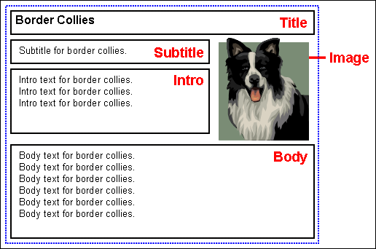
Template
Static template
<html>
<h1> This is an example </h1>
<h1><%= data[“myVar”] %> </h1>
</html>
ENSTA Bretagne Monitor Your Robot 35 / 49
Notes:
Skeleton
wanted notice

Slide 36

Configuration
Title = “Lost dog”
Subtitle = “42 $ cash reward”
Intro = “Last seen today”
Body = “Call 1234 for more information”
Static template
<html>
<h1> This is an example </h1>
<h1><%= data[“myVar”] %> </h1>
</html>
YAML
myVar: “This is another example”
ENSTA Bretagne Monitor Your Robot 36 / 49
Notes:
wanted notice

Slide 37


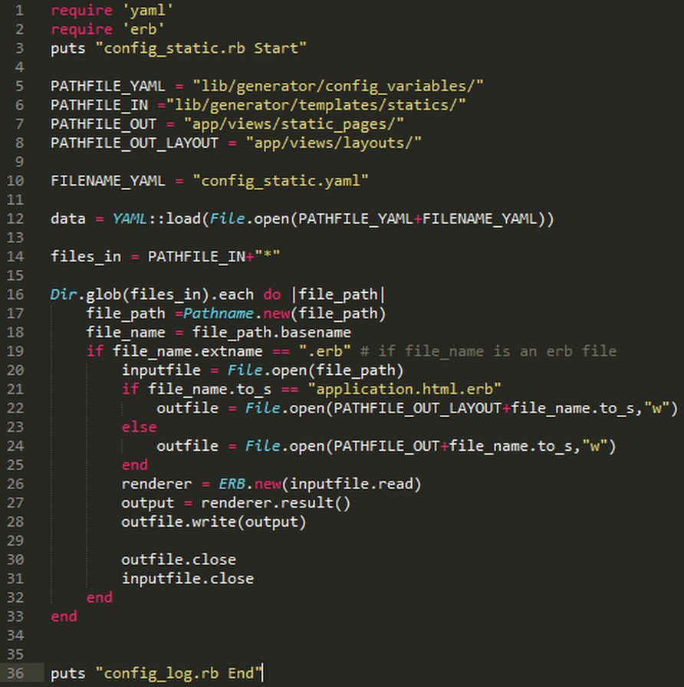
Script
<html>
<h1> This in an example </h1>
<% for i in 0..42 %>
<%= puts i%>
<% end %>
</html>
Ruby Script
data = YAML::load()
ENSTA Bretagne Monitor Your Robot 37 / 49
Notes:
music score
What to do and when to do

Slide 38
Generation of
static pages
ENSTA Bretagne Monitor Your Robot 38 / 49
Notes:
i will try to explain you

Slide 39
Static template
YAML
<html>
<%= data[“sponsors”][0][“name”] %>
</html>
<html>
<h1> This is an example </h1>
<h1><%= data[“myVar”] %> </h1>
</html>
myVar: “This is another example”
Static page
<html>
<h1> This is an example </h1>
<h2> This is another example </h2>
</html>
Ruby Script
data = YAML::load()
data = YAML::load()
ROR
View
This is an example
This is another example
Used by
Generate
ENSTA Bretagne Monitor Your Robot 39 / 49

Slide 40
I. Methods of work
Agile Development MYR
Quality Commitment in MYR
II. Improvements since SWARMON
Changes in the Map rendering
Example of implementation
Improvement in the CSS and the Layout
Improvement in the database
III. New technologies in MYR
How to use Ajax in Rails
Website generator
Impact on performance
Impact on the server of a GET request on the page « Real-Time »
ENSTA Bretagne Monitor Your Robot 40 / 49
Notes:
Now we will try to explain you

Slide 41
Comparaison of performance
SWARMON
Monitor Your Robot
Started GET "/view" for 92.139.129.36 at 2015-03-11 20:26:01 +0100 Processing by ViewController#view as HTML Rendered view/view.html.erb within layouts/noturbolinks (4.4ms) Completed 200 OK in 943ms (Views: 940.6ms | ActiveRecord: 0.3ms) Started GET "/stylesheets/styles.css" for 92.139.129.36 at 2015-03-11 20:26:02 +0 100 Rendered /home/apidev/.rvm/gems/ruby-2.0.0-p247/gems/actionpack-4.1.0/lib/action_dispatch/middleware/templates/rescues/_trace.html.erb (2.4ms) Rendered /home/apidev/.rvm/gems/ruby-2.0.0-p247/gems/actionpack-4.1.0/lib/actio n_dispatch/middleware/templates/routes/_route.html.erb (18.0ms) Rendered /home/apidev/.rvm/gems/ruby-2.0.0-p247/gems/actionpack-4.1.0/lib/action_dispatch/middleware/templates/routes/_table.html.erb (2.4ms) Started GET "/assets/jquery.js?body=1" for 92.139.129.36 at 2015-03-11 20:26:02 +0100 Started GET "/assets/jquery.turbolinks.js?body=1" for 92.139.129.36 at 2015-03-1120:26:02 +0100 Started GET "/assets/jquery_ujs.js?body=1" for 92.139.129.36 at 2015-03-11 20:26:02 +0100 Started GET "/assets/jquery.cookie.js?body=1" for 92.139.129.36 at 2015-03-11 20:26:02 +0100 Started GET "/assets/underscore.js?body=1" for 92.139.129.36 at 2015-03-11 20:26: 02 +0100 Started GET "/assets/gmaps/base.js?body=1" for 92.139.129.36 at 2015-03-11 20:26:02 +0100 Started GET "/assets/gmaps/base/base.js?body=1" for 92.139.129.36 at 2015-03-11 2 0:26:02 +0100 Started GET "/assets/gmaps/objects/base_builder.js?body=1" for 92.139.129.36 at 2 015-03-11 20:26:02 +0100 Started GET "/assets/gmaps/objects/builder.js?body=1" for 92.139.129.36 at 2015-03-11 20:26:02 +0100 Started GET "/assets/gmaps/objects/handler.js?body=1" for 92.139.129.36 at 2015-03-11 20:26:03 +0100 Started GET "/assets/gmaps/google/objects/common.js?body=1" for 92.139.129.36 at2015-03-11 20:26:03 +0100 Started GET "/assets/gmaps/objects/null_clusterer.js?body=1" for 92.139.129.36 at 2015-03-11 20:26:03 +0100 Started GET "/assets/gmaps/google/builders/bound.js?body=1" for 92.139.129.36 at2015-03-11 20:26:03 +0100 Started GET "/assets/gmaps/google/builders/circle.js?body=1" for 92.139.129.36 at 2015-03-11 20:26:03 +0100 Started GET "/assets/gmaps/google/builders/clusterer.js?body=1" for 92.139.129.36 at 2015-03-11 20:26:03 +0100 Started GET "/assets/gmaps/google/builders/kml.js?body=1" for 92.139.129.36 at 2015-03-11 20:26:03 +0100 Started GET "/assets/gmaps/google/builders/map.js?body=1" for 92.139.129.36 at 2015-03-11 20:26:03 +0100 Started GET "/assets/gmaps/google/builders/marker.js?body=1" for 92.139.129.36 at2015-03-11 20:26:03 +0100 Started GET "/assets/gmaps/google/builders/polygon.js?body=1" for 92.139.129.36 a t 2015-03-11 20:26:03 +0100 Started GET "/assets/gmaps/google/builders/polyline.js?body=1" for 92.139.129.36at 2015-03-11 20:26:03 +0100 Started GET "/assets/gmaps/google/objects/circle.js?body=1" for 92.139.129.36 at 2015-03-11 20:26:03 +0100 Started GET "/assets/gmaps/google/objects/clusterer.js?body=1" for 92.139.129.36 at 2015-03-11 20:26:03 +0100 Started GET "/assets/gmaps/google/objects/bound.js?body=1" for 92.139.129.36 at 2015-03-11 20:26:03 +0100 Started GET "/assets/gmaps/google/objects/kml.js?body=1" for 92.139.129.36 at 2015-03-11 20:26:03 +0100 Started GET "/assets/gmaps/google/objects/map.js?body=1" for 92.139.129.36 at 2015-03-11 20:26:03 +0100 Started GET "/assets/gmaps/google/objects/marker.js?body=1" for 92.139.129.36 at2015-03-11 20:26:03 +0100 Started GET "/assets/gmaps/google/objects/polygon.js?body=1" for 92.139.129.36 at2015-03-11 20:26:03 +0100 Started GET "/assets/gmaps/google/objects/polyline.js?body=1" for 92.139.129.36 at 2015-03-11 20:26:03 +0100 Started GET "/assets/gmaps/google/primitives.js?body=1" for 92.139.129.36 at 2015 -03-11 20:26:03 +0100 Started GET "/assets/gmaps/google.js?body=1" for 92.139.129.36 at 2015-03-11 20:26:03 +0100 Started GET "/assets/turbolinks.js?body=1" for 92.139.129.36 at 2015-03-11 20:2604 +0100 Started GET "/assets/coordinates.js?body=1" for 92.139.129.36 at 2015-03-11 20:26:04 +0100 Started GET "/assets/contact.js?body=1" for 92.139.129.36 at 2015-03-11 20:26:04+0100 Started GET "/assets/home.js?body=1" for 92.139.129.36 at 2015-03-11 20:26:04 +0100 Started GET "/assets/members.js?body=1" for 92.139.129.36 at 2015-03-11 20:26:04+0100 Started GET "/assets/missions.js?body=1" for 92.139.129.36 at 2015-03-11 20:26:04 +0100 Started GET "/assets/myaccount.js?body=1" for 92.139.129.36 at 2015-03-11 20:26:04 +0100 Started GET "/assets/robots.js?body=1" for 92.139.129.36 at 2015-03-11 20:26:04 +0100 Started GET "/assets/teams.js?body=1" for 92.139.129.36 at 2015-03-11 20:26:04 +0100 Started GET "/assets/trackers.js?body=1" for 92.139.129.36 at 2015-03-11 20:26:04+0100 Started GET "/assets/tries.js?body=1" for 92.139.129.36 at 2015-03-11 20:26:04 +0100 Started GET "/assets/what.js?body=1" for 92.139.129.36 at 2015-03-11 20:26:04 +0100 Started GET "/assets/application.js?body=1" for 92.139.129.36 at 2015-03-11 20:26 :04 +0100 Started GET "/mapp" for 92.139.129.36 at 2015-03-11 20:26:05 +0100
Processing by ViewController#mapp as JS Rendered view/_mapp.html.erb (1.6ms) Rendered view/mapp.js.erb (8.2ms) Completed 200 OK in 25ms (Views: 22.0ms | ActiveRecord: 0.0ms) Started GET "/choiceteams" for 92.139.129.36 at 2015-03-11 20:26:05 +0100 Processing by ViewController#choiceteams as JS Team Load (0.6ms) SELECT "teams".* FROM "teams" Robot Load (0.4ms) SELECT "robots".* FROM "robots" WHERE "robots"."team_id" = 1 LIMIT 1 Robot Load (0.3ms) SELECT "robots".* FROM "robots" WHERE "robots"."team_id" = 2 LIMIT 1 Robot Load (0.3ms) SELECT "robots".* FROM "robots" WHERE "robots"."team_id" = 3 LIMIT 1 Robot Load (0.3ms) SELECT "robots".* FROM "robots" WHERE "robots"."team_id" = 4 LIMIT 1 Robot Load (0.3ms) SELECT "robots".* FROM "robots" WHERE "robots"."team_id" = 5 LIMIT 1 Robot Load (0.3ms) SELECT "robots".* FROM "robots" WHERE "robots"."team_id" = 7 LIMIT 1 Rendered view/_choiceteams.html.erb (29.6ms) Rendered view/choiceteams.js.erb (37.1ms) Completed 200 OK in 50ms (Views: 45.1ms | ActiveRecord: 3.4ms)
Started GET "/real-time" for ::1 at 2015-03-11 22:35:22 +0100 ActiveRecord::SchemaMigration Load (1.0ms) SELECT "schema_migrations".* FROM"schema_migrations" Processing by RealTimeController#show as HTML (1.0ms) SELECT COUNT(*) FROM "missions" WHERE (start < '2015-03-11 21:35:23. 029305' AND '2015-03-11 21:35:23.029305' < end) Rendered real_time/show.html.erb within layouts/application (68.0ms) Completed 200 OK in 304ms (Views: 267.0ms | ActiveRecord: 1.0ms) Started GET "/assets/jquery-87424c3c19e96d4fb033c10ebe21ec40.js?body=1" for ::1 at 2015-03-11 22:35:23 +0100 Started GET "/assets/jquery.cookie-6f1aca88e6c397046084354934853e04.js?body=1" for ::1 at 2015-03-11 22:35:23 +0100 Started GET "/assets/jquery_ujs-e27bd20a10d29655845a22d71ef94f2f.js?body=1" for::1 at 2015-03-11 22:35:23 +0100 Started GET "/assets/functions-d97ed371128fcea95ddbe699f474594b.js?body=1" for ::1 at 2015-03-11 22:35:23 +0100 Started GET "/assets/application-fcbbf6628d6f1d1ebf9b5fcf689bd2e9.js?body=1" for ::1 at 2015-03-11 22:35:23 +0100 Started GET "/assets/real_time-6040e6444b4d7f760bf2778eb61a3750.js?body=1" for ::1 at 2015-03-11 22:35:23 +0100
Legend:
Get HTML and CSS
Get Javascripts
Initialize GUI
ENSTA Bretagne Monitor Your Robot 41 / 49

Slide 42
Comparaison of performance
SWARMON
: 6 GET Requests
: 45 GET Requests
MYR
Started GET "/view" for 92.139.129.36 at 2015-03-11 20:26:01 +0100 Processing by ViewController#view as HTML Rendered view/view.html.erb within layouts/noturbolinks (4.4ms) Completed 200 OK in 943ms (Views: 940.6ms | ActiveRecord: 0.3ms) Started GET "/stylesheets/styles.css" for 92.139.129.36 at 2015-03-11 20:26:02 +0 100 Rendered /home/apidev/.rvm/gems/ruby-2.0.0-p247/gems/actionpack-4.1.0/lib/action_dispatch/middleware/templates/rescues/_trace.html.erb (2.4ms) Rendered /home/apidev/.rvm/gems/ruby-2.0.0-p247/gems/actionpack-4.1.0/lib/actio n_dispatch/middleware/templates/routes/_route.html.erb (18.0ms) Rendered /home/apidev/.rvm/gems/ruby-2.0.0-p247/gems/actionpack-4.1.0/lib/action_dispatch/middleware/templates/routes/_table.html.erb (2.4ms) Started GET "/assets/jquery.js?body=1" for 92.139.129.36 at 2015-03-11 20:26:02 +0100 Started GET "/assets/jquery.turbolinks.js?body=1" for 92.139.129.36 at 2015-03-1120:26:02 +0100 Started GET "/assets/jquery_ujs.js?body=1" for 92.139.129.36 at 2015-03-11 20:26:02 +0100 Started GET "/assets/jquery.cookie.js?body=1" for 92.139.129.36 at 2015-03-11 20:26:02 +0100 Started GET "/assets/underscore.js?body=1" for 92.139.129.36 at 2015-03-11 20:26: 02 +0100 Started GET "/assets/gmaps/base.js?body=1" for 92.139.129.36 at 2015-03-11 20:26:02 +0100 Started GET "/assets/gmaps/base/base.js?body=1" for 92.139.129.36 at 2015-03-11 2 0:26:02 +0100 Started GET "/assets/gmaps/objects/base_builder.js?body=1" for 92.139.129.36 at 2 015-03-11 20:26:02 +0100 Started GET "/assets/gmaps/objects/builder.js?body=1" for 92.139.129.36 at 2015-03-11 20:26:02 +0100 Started GET "/assets/gmaps/objects/handler.js?body=1" for 92.139.129.36 at 2015-03-11 20:26:03 +0100 Started GET "/assets/gmaps/google/objects/common.js?body=1" for 92.139.129.36 at2015-03-11 20:26:03 +0100 Started GET "/assets/gmaps/objects/null_clusterer.js?body=1" for 92.139.129.36 at 2015-03-11 20:26:03 +0100 Started GET "/assets/gmaps/google/builders/bound.js?body=1" for 92.139.129.36 at2015-03-11 20:26:03 +0100 Started GET "/assets/gmaps/google/builders/circle.js?body=1" for 92.139.129.36 at 2015-03-11 20:26:03 +0100 Started GET "/assets/gmaps/google/builders/clusterer.js?body=1" for 92.139.129.36 at 2015-03-11 20:26:03 +0100 Started GET "/assets/gmaps/google/builders/kml.js?body=1" for 92.139.129.36 at 2015-03-11 20:26:03 +0100 Started GET "/assets/gmaps/google/builders/map.js?body=1" for 92.139.129.36 at 2015-03-11 20:26:03 +0100 Started GET "/assets/gmaps/google/builders/marker.js?body=1" for 92.139.129.36 at2015-03-11 20:26:03 +0100 Started GET "/assets/gmaps/google/builders/polygon.js?body=1" for 92.139.129.36 a t 2015-03-11 20:26:03 +0100 Started GET "/assets/gmaps/google/builders/polyline.js?body=1" for 92.139.129.36at 2015-03-11 20:26:03 +0100 Started GET "/assets/gmaps/google/objects/circle.js?body=1" for 92.139.129.36 at 2015-03-11 20:26:03 +0100 Started GET "/assets/gmaps/google/objects/clusterer.js?body=1" for 92.139.129.36 at 2015-03-11 20:26:03 +0100 Started GET "/assets/gmaps/google/objects/bound.js?body=1" for 92.139.129.36 at 2015-03-11 20:26:03 +0100 Started GET "/assets/gmaps/google/objects/kml.js?body=1" for 92.139.129.36 at 2015-03-11 20:26:03 +0100 Started GET "/assets/gmaps/google/objects/map.js?body=1" for 92.139.129.36 at 2015-03-11 20:26:03 +0100 Started GET "/assets/gmaps/google/objects/marker.js?body=1" for 92.139.129.36 at2015-03-11 20:26:03 +0100 Started GET "/assets/gmaps/google/objects/polygon.js?body=1" for 92.139.129.36 at2015-03-11 20:26:03 +0100 Started GET "/assets/gmaps/google/objects/polyline.js?body=1" for 92.139.129.36 at 2015-03-11 20:26:03 +0100 Started GET "/assets/gmaps/google/primitives.js?body=1" for 92.139.129.36 at 2015 -03-11 20:26:03 +0100 Started GET "/assets/gmaps/google.js?body=1" for 92.139.129.36 at 2015-03-11 20:26:03 +0100 Started GET "/assets/turbolinks.js?body=1" for 92.139.129.36 at 2015-03-11 20:2604 +0100 Started GET "/assets/coordinates.js?body=1" for 92.139.129.36 at 2015-03-11 20:26:04 +0100 Started GET "/assets/contact.js?body=1" for 92.139.129.36 at 2015-03-11 20:26:04+0100 Started GET "/assets/home.js?body=1" for 92.139.129.36 at 2015-03-11 20:26:04 +0100 Started GET "/assets/members.js?body=1" for 92.139.129.36 at 2015-03-11 20:26:04+0100 Started GET "/assets/missions.js?body=1" for 92.139.129.36 at 2015-03-11 20:26:04 +0100 Started GET "/assets/myaccount.js?body=1" for 92.139.129.36 at 2015-03-11 20:26:04 +0100 Started GET "/assets/robots.js?body=1" for 92.139.129.36 at 2015-03-11 20:26:04 +0100 Started GET "/assets/teams.js?body=1" for 92.139.129.36 at 2015-03-11 20:26:04 +0100 Started GET "/assets/trackers.js?body=1" for 92.139.129.36 at 2015-03-11 20:26:04+0100 Started GET "/assets/tries.js?body=1" for 92.139.129.36 at 2015-03-11 20:26:04 +0100 Started GET "/assets/what.js?body=1" for 92.139.129.36 at 2015-03-11 20:26:04 +0100 Started GET "/assets/application.js?body=1" for 92.139.129.36 at 2015-03-11 20:26 :04 +0100 Started GET "/mapp" for 92.139.129.36 at 2015-03-11 20:26:05 +0100
Processing by ViewController#mapp as JS Rendered view/_mapp.html.erb (1.6ms) Rendered view/mapp.js.erb (8.2ms) Completed 200 OK in 25ms (Views: 22.0ms | ActiveRecord: 0.0ms) Started GET "/choiceteams" for 92.139.129.36 at 2015-03-11 20:26:05 +0100 Processing by ViewController#choiceteams as JS Team Load (0.6ms) SELECT "teams".* FROM "teams" Robot Load (0.4ms) SELECT "robots".* FROM "robots" WHERE "robots"."team_id" = 1 LIMIT 1 Robot Load (0.3ms) SELECT "robots".* FROM "robots" WHERE "robots"."team_id" = 2 LIMIT 1 Robot Load (0.3ms) SELECT "robots".* FROM "robots" WHERE "robots"."team_id" = 3 LIMIT 1 Robot Load (0.3ms) SELECT "robots".* FROM "robots" WHERE "robots"."team_id" = 4 LIMIT 1 Robot Load (0.3ms) SELECT "robots".* FROM "robots" WHERE "robots"."team_id" = 5 LIMIT 1 Robot Load (0.3ms) SELECT "robots".* FROM "robots" WHERE "robots"."team_id" = 7 LIMIT 1 Rendered view/_choiceteams.html.erb (29.6ms) Rendered view/choiceteams.js.erb (37.1ms) Completed 200 OK in 50ms (Views: 45.1ms | ActiveRecord: 3.4ms)
Started GET "/real-time" for ::1 at 2015-03-11 22:35:22 +0100 ActiveRecord::SchemaMigration Load (1.0ms) SELECT "schema_migrations".* FROM"schema_migrations" Processing by RealTimeController#show as HTML (1.0ms) SELECT COUNT(*) FROM "missions" WHERE (start < '2015-03-11 21:35:23. 029305' AND '2015-03-11 21:35:23.029305' < end) Rendered real_time/show.html.erb within layouts/application (68.0ms) Completed 200 OK in 304ms (Views: 267.0ms | ActiveRecord: 1.0ms) Started GET "/assets/jquery-87424c3c19e96d4fb033c10ebe21ec40.js?body=1" for ::1 at 2015-03-11 22:35:23 +0100 Started GET "/assets/jquery.cookie-6f1aca88e6c397046084354934853e04.js?body=1" for ::1 at 2015-03-11 22:35:23 +0100 Started GET "/assets/jquery_ujs-e27bd20a10d29655845a22d71ef94f2f.js?body=1" for::1 at 2015-03-11 22:35:23 +0100 Started GET "/assets/functions-d97ed371128fcea95ddbe699f474594b.js?body=1" for ::1 at 2015-03-11 22:35:23 +0100 Started GET "/assets/application-fcbbf6628d6f1d1ebf9b5fcf689bd2e9.js?body=1" for ::1 at 2015-03-11 22:35:23 +0100 Started GET "/assets/real_time-6040e6444b4d7f760bf2778eb61a3750.js?body=1" for ::1 at 2015-03-11 22:35:23 +0100
Number of requests to send:
39
Max number of parallel connexions:
6
Common value for ping:
50ms to 100 ms
Time needed:
325 ms to 650 ms
To be compared to:
Rendering a common web page:
Less than one second
ENSTA Bretagne Monitor Your Robot 42 / 49

Slide 43
Open sea test
ENSTA Bretagne Monitor Your Robot 43 / 49

Slide 44
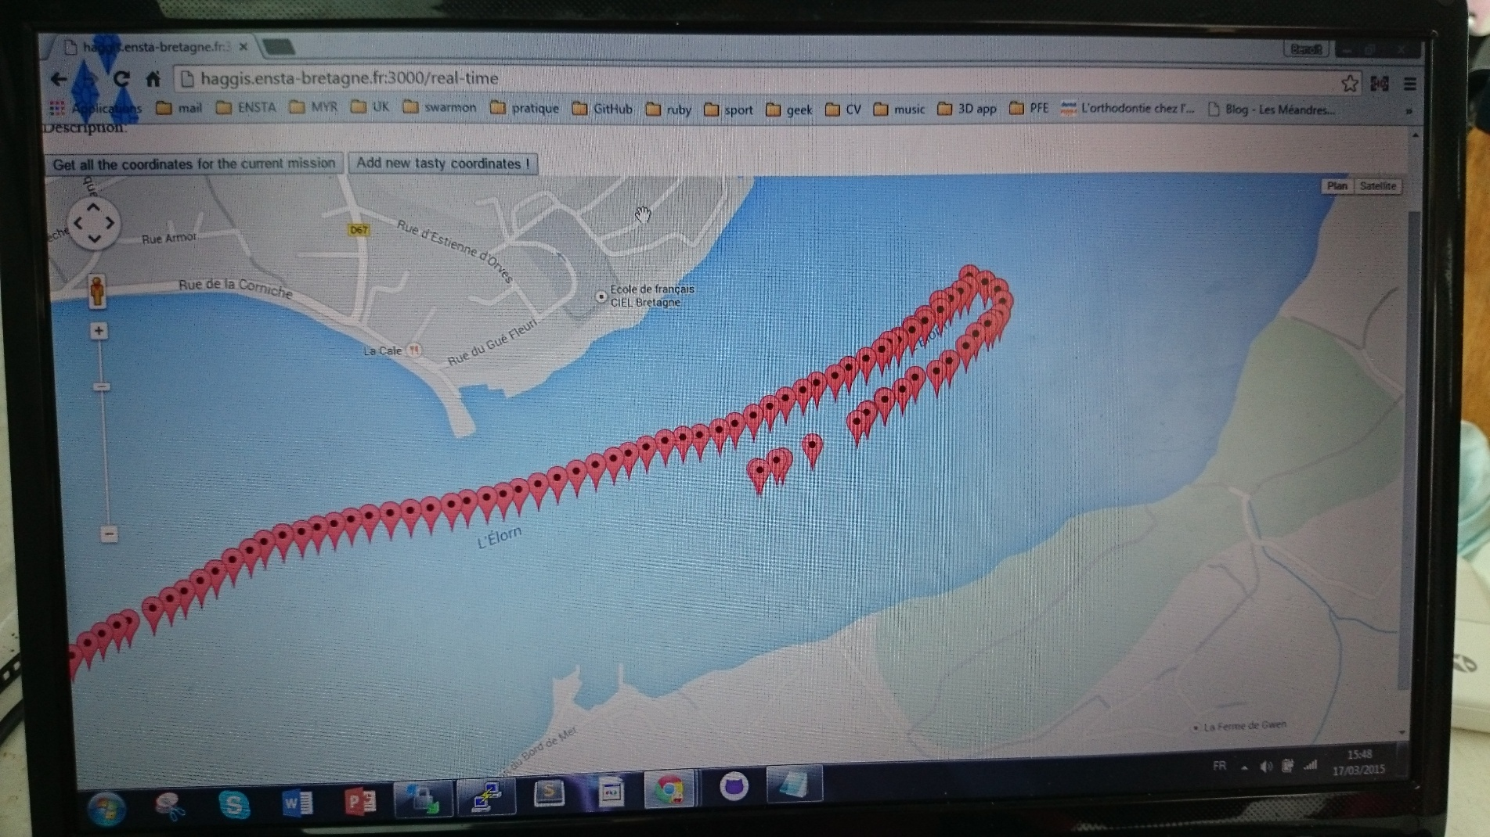
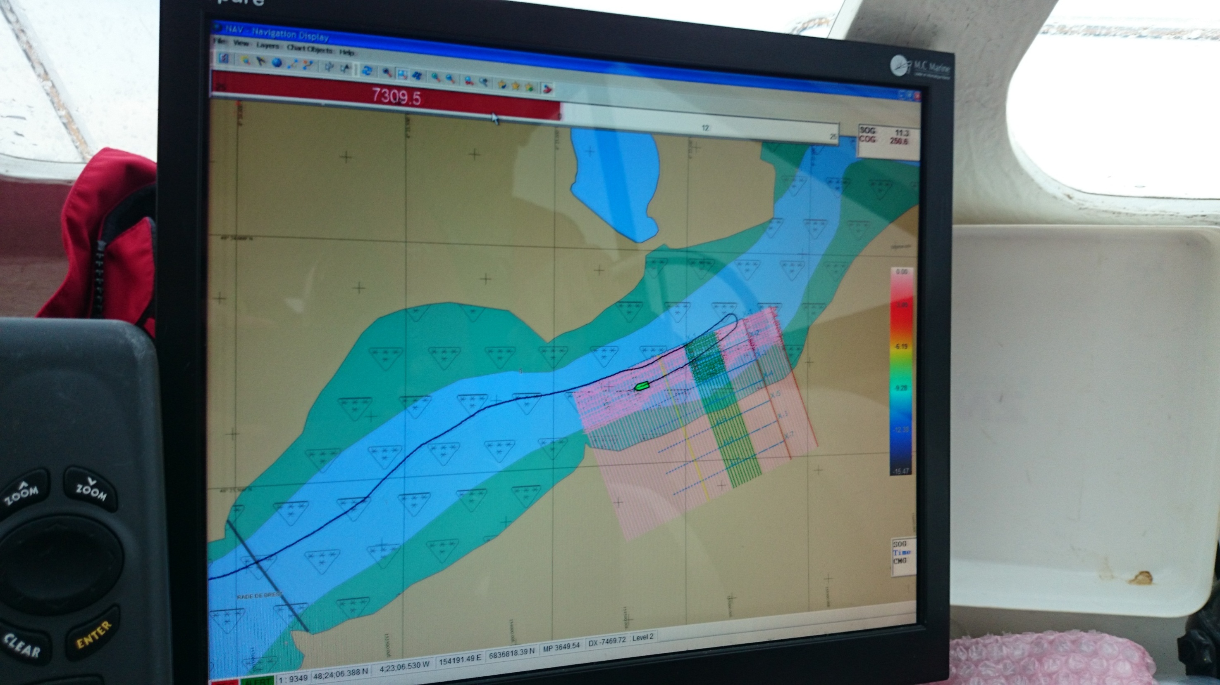
Open sea test: precision on the map
Monitor your robot
Boat’s instumentation
ENSTA Bretagne Monitor Your Robot 44 / 49

Slide 45
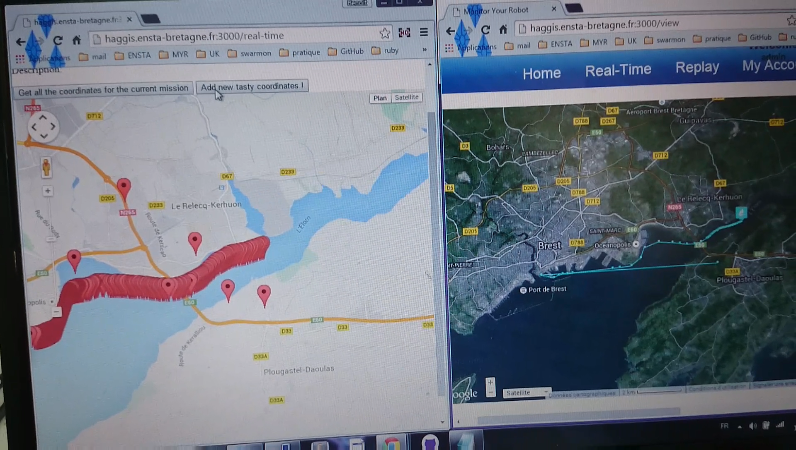
Open sea test: comparison between the two refresh methods
ENSTA Bretagne Monitor Your Robot 45 / 49

Slide 46
Conclusion
ENSTA Bretagne Monitor Your Robot 46 / 49

Slide 47
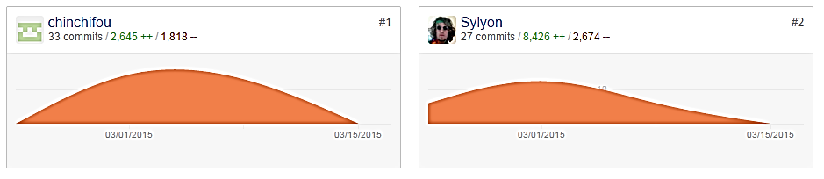
To conclude: key figures about Monitor Your Robot
In less than 3 weeks:
GitHub
50 commits
More than 10 000 lines of codes
Stormboard
32 post-its
Reports
1 State of the Art
2 Status reports
1 Final report
ENSTA Bretagne Monitor Your Robot 47 / 49

Slide 48
To conclude: key features
New « Real-Time » page
New CSS and website generator
New database and possibility to create markers for a specific mission
Better use of technologies
Good quality of code to allow future developments
ENSTA Bretagne Monitor Your Robot 48 / 49

Slide 49

Any Questions ?
ENSTA Bretagne Monitor Your Robot 49 / 49

Slide 50
ANNEXES
ENSTA Bretagne Monitor Your Robot 50 / 72

Slide 51
I. Methods of work
Agile Development MYR
Quality Commitment in MYR
II. Improvements since SWARMON
Changes in the Map rendering
Example of implementation
Improvement in the CSS and the Layout
Improvement in the database
III. New technologies in MYR
How to use Ajax in Rails
Website generator
Impact on performance
Website generator
ENSTA Bretagne Monitor Your Robot 51 / 72

Slide 52
Generation of
dynamic pages
ENSTA Bretagne Monitor Your Robot 52 / 72

Slide 53
Dynamic template
<html>
<% for i in 1..2 %>
<h1><%= rubyVar %> </h1>
<% end %>
</html>
YAML
rubyVar : “hello world”
Dynamic page
View
<html>
<% for i in 1..2 %>
<h1><%= rubyVar %> </h1>
<% end %>
</html>
Ruby Script
ROR
Hello world
Hello world
Helper
def rubyVar
return “hello world”
end
Used by
Generate
ENSTA Bretagne Monitor Your Robot 53 / 72

Slide 54
I. Methods of work
Agile Development MYR
Quality Commitment in MYR
II. Improvements since SWARMON
Changes in the Map rendering
Example of implementation
Improvement in the CSS and the Layout
Improvement in the database
III. New technologies in MYR
How to use Ajax in Rails
Website generator
Impact on performance
Rake file
ENSTA Bretagne Monitor Your Robot 54 / 72

Slide 55
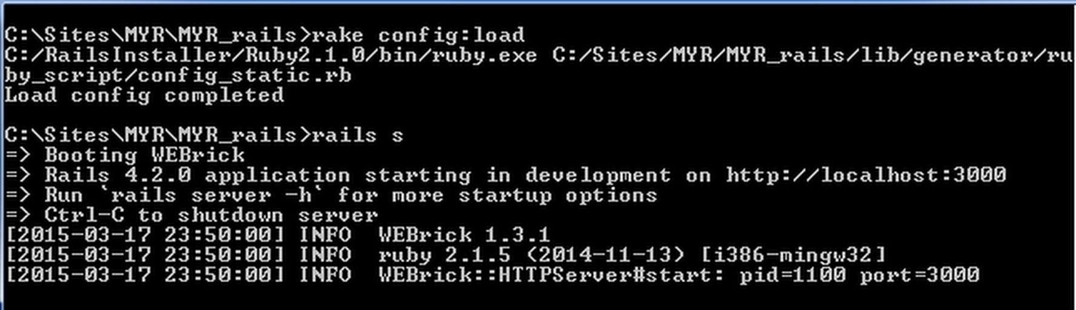
How to generate a customized web site ?
ENSTA Bretagne Monitor Your Robot 55 / 72

Slide 56
ANNEXES:
- Client side impact of a GET request on /view (SWARMON)
Impact of cache on javascripts
Analysis of performance on /view (SWARMON)
Format used for coordinates
Complete Stormboard
ENSTA Bretagne Monitor Your Robot 56 / 72

Slide 57
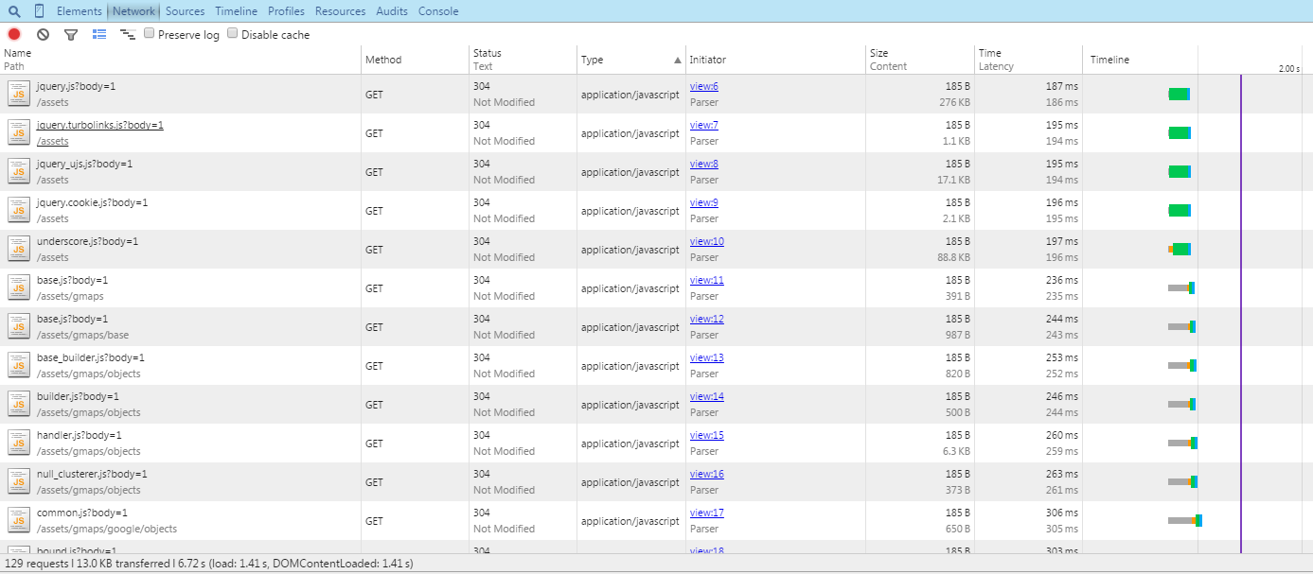
Client side Impact of a GET request on /view (SWARMON)
129 Requests
ENSTA Bretagne Monitor Your Robot 57 / 72

Slide 58
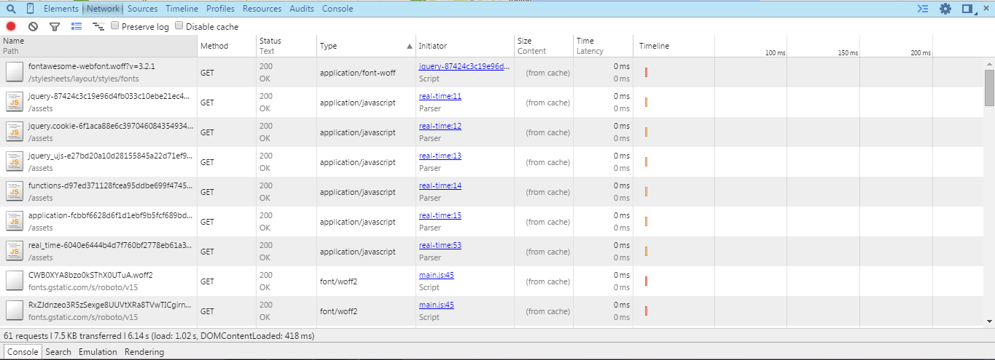
Impact of cache on javascripts
61 Requests
ENSTA Bretagne Monitor Your Robot 58 / 72

Slide 59
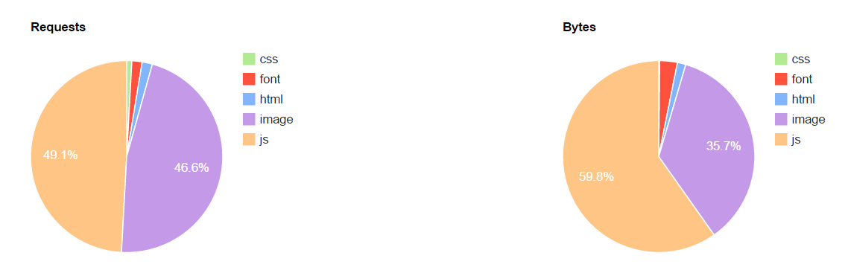
Analysis of performance on /view (SWARMON)
ENSTA Bretagne Monitor Your Robot 59 / 72

Slide 60
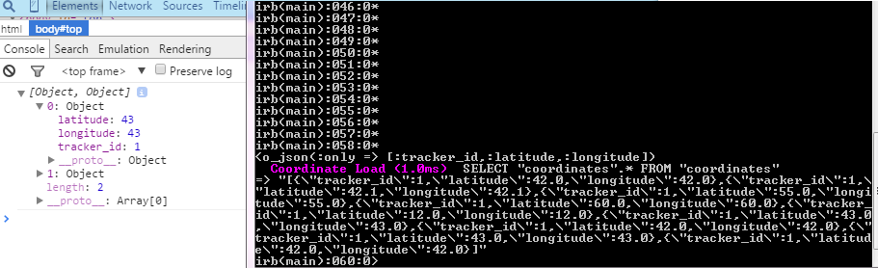
Format used for coordinates
ENSTA Bretagne Monitor Your Robot 60 / 72

Slide 61
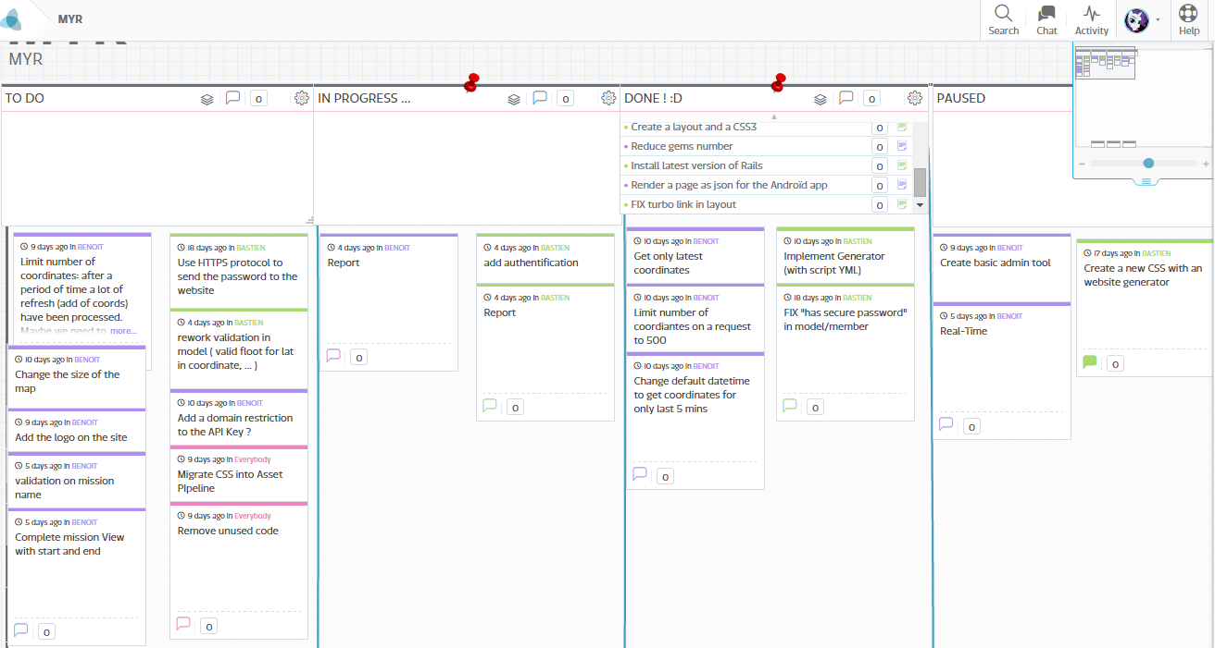
« Stormboard » of Monitor Your Robot
ENSTA Bretagne Monitor Your Robot 61 / 72

Slide 62
Bibliography:
- "WebPageTest." WebPagetest Test Result. N.p., n.d. Web. 15 Mar. 2015.
ENSTA Bretagne Monitor Your Robot 62 / 72

Slide 63
Workspace
ENSTA Bretagne Monitor Your Robot 63 / 72

Slide 64
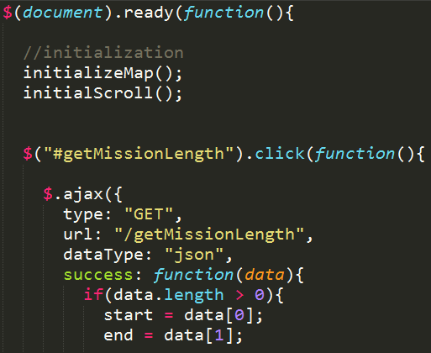
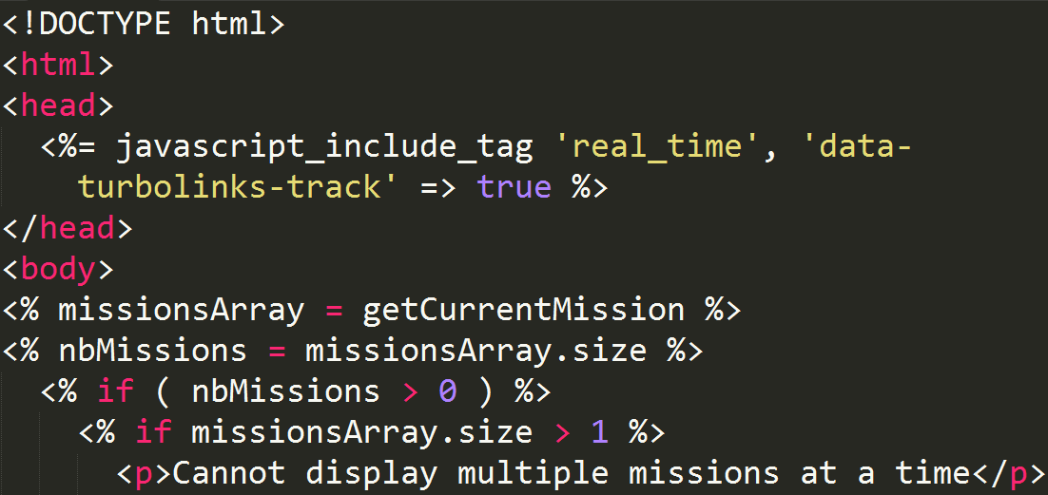
ENSTA Bretagne Monitor Your Robot 64 / 72

Slide 65
Javascript.js
/javascripts
/assets
/app
view.html.erb
/views
ENSTA Bretagne Monitor Your Robot 65 / 72

Slide 66
application.js
/javascripts
/assets
/app
other.js
another.js
view.html.erb
/views
assets.rb
/initializers
/config
ENSTA Bretagne Monitor Your Robot 66 / 72

Slide 67
application.js
/javascripts
Global JavaScript files
/app
/assets
required.js
notrequired.js
Page specific JavaScript files
ENSTA Bretagne Monitor Your Robot 67 / 72

Slide 68
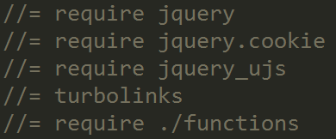
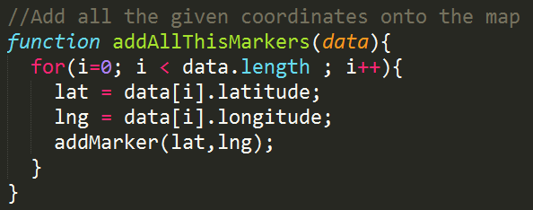
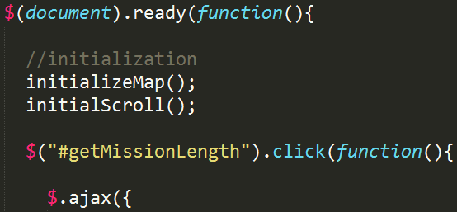
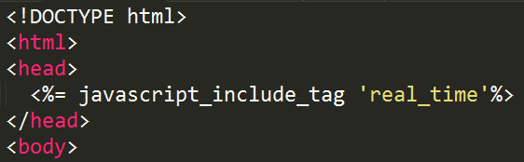
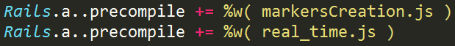
application.js
/javascripts
/assets
/app
functions.js
real_time.js
real_time.html.erb
/views
assets.rb
/initializers
/config
Legend:
Global JavaScript files
Page specific JavaScript files
View with a link to its JavaScript file
Precompilation of specific JavaScript files
Link between files
ENSTA Bretagne 68 / 72

Slide 69
1
Legend:
Ruby files are colored in PINK
html.erb files are colored in BLUE
JavaScript files are coloured in GREEN
javscript
view
7
2
6
5
routes
controller
model
3
4
The view receives an event which trigger an action of the Jquery script.
The Ajax request of the jQuery script calls a URL.
The routes.rb file establishes a link between the provided URL and the corresponding controller action.
The method of the controller process its actions. The controller can retrieve data from the database by directly calling Ruby Classes.
The ActiveRecord:: ORM retrieves the data by using SQL requests and send them back to the controller as a Ruby Object.
The controller send the data back to the jQuery script using JSON format.
The JQuery script uses the retrieved data to change the content of the web page.
1
2
3
4
5
6
7
ENSTA Bretagne Monitor Your Robot 69 / 72

Slide 70
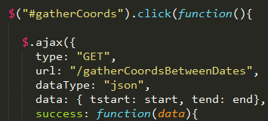
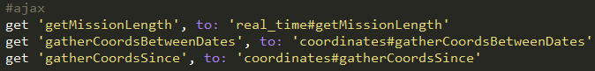
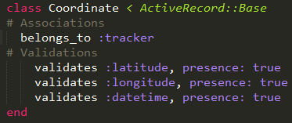
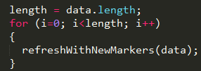
1
2
3
4
5
6
7
ENSTA Bretagne Monitor Your Robot 70 / 72

Slide 71
view
partial view
Legend:
Ruby files are colored in PINK
html.erb files are colored in BLUE
Js.erb files are coloured in YELLOW
5
1
4
routes
controller
javscript
2
3
The view receives an event which triggers an Ajax action (remote: true).
The routes.rb file uses the given action name to find the corresponding method and controller.
The controller can do some preprocessing but it can also do nothing at all. In fact the method in the controller is just needed to respect the MVC template.
This jQuery script directly replaces a <div> in the original html.erb with a piece of code from another html.erb file.
This second html.erb file is named “partial” as it is only a partial part of the final rendered web page. Its name must start with an underscore or Rails will not recognize it as a “partial”.
1
2
3
4
5
ENSTA Bretagne Monitor Your Robot 71 / 72

Slide 72
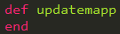
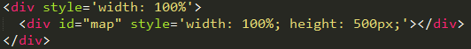
1
2
3
4
5
ENSTA Bretagne Monitor Your Robot 72 / 72

